Slide 1
Remote Method Invocation

Slide 2
RMI (Remote Method Invocation)
The RMI (Remote Method Invocation) is an API that provides a mechanism to create distributed application in java.
The RMI allows an object to invoke methods on an object running in another JVM.
The RMI provides remote communication between the applications using two objects stub and skeleton.

Slide 3
Working of RMI
RMI uses stub and skeleton object for communication with the remote object.
A remote object is an object whose method can be invoked from another JVM.

Slide 4
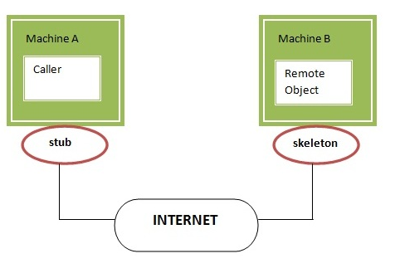
Working of RMI

Slide 5
stub
The stub is an object, acts as a gateway for the client side. All the outgoing requests are routed through it.
It resides at the client side and represents the remote object.
When the caller invokes method on the stub object, it does the following tasks:
It initiates a connection with remote Virtual Machine (JVM),
It writes and transmits (marshals) the parameters to the remote Virtual Machine (JVM),
It waits for the result
It reads (unmarshals) the return value or exception, and
It finally, returns the value to the caller.

Slide 6
skeleton
The skeleton is an object, acts as a gateway for the server side object.
All the incoming requests are routed through it.
When the skeleton receives the incoming request, it does the following tasks:
It reads the parameter for the remote method
It invokes the method on the actual remote object, and
It writes and transmits (marshals) the result to the caller.

Slide 7
Steps to create RMI application
Create the remote interface
Provide the implementation of the remote interface
Compile the implementation class and create the stub and skeleton objects using the rmic tool
Start the registry service by rmiregistry tool
Create and start the remote application
Create and start the client application

Slide 8
RMI Example
In the RMI application, both client and server interacts with the remote interface.
The client application invokes methods on the proxy object, RMI sends the request to the remote JVM.
The return value is sent back to the proxy object and then to the client application.

Slide 9
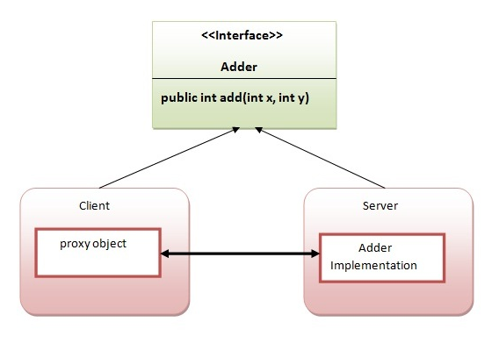
Pictorially

Slide 10
Creation of interface (On Server Machine)
import java.rmi.*;
public interface Adder extends Remote{
public int add(int x,int y)throws RemoteException;
}

Slide 11
Implementation of the remote interface (On Server Machine)
import java.rmi.*;
import java.rmi.server.*;
public class A extends UnicastRemoteObject implements Adder{
A() throws RemoteException{
super();
} //End of Constructor
public int add(int x,int y){
return x+y;
}//End of method
}

Slide 12
Next Steps
Create the stub and skeleton objects
On command prompt, type:
rmic AdderRemote
Start the registry service by the rmiregistry tool
On command prompt, type:
rmiregistry 7860 (or any other port number)

Slide 13
Create and run the server application
Now rmi services need to be hosted in a server process. The Naming class provides methods to get and store the remote object.
import java.rmi.*;
import java.rmi.registry.*;
public class MyServer{
public static void main(String args[]){
try{
Adder skeleton=new AdderRemote();
Naming.rebind("rmi://localhost:7860/abc",skeleton);
}catch(Exception e){System.out.println(e);}
}
}

Slide 14
Create and run the client application
import java.rmi.*;
public class MyClient{
public static void main(String args[]){
try{
Adder stub=(Adder)Naming.lookup("rmi://localhost:7860/abc");
System.out.println(stub.add(34,4));
}catch(Exception e){}
}
}

Slide 15
Execution
For running this rmi example,
1) compile all the java files
javac *.java
2)create stub and skeleton object by rmic tool
rmic AdderRemote
3)start rmi registry in one command prompt
rmiregistry 7860
4)start the server in another command prompt
java MyServer
5)start the client application in another command prompt
java MyClient

